Slide 1
ADS Draft
Team Argus

Slide 2
Overview
Key Requirements
Meta Architecture
Super Layer Design
PixelSense
Transfer
Tablet/Lynx
Requirements Mapping
OS Dependencies
Testing Considerations

Slide 3
Key Requirements
3.1: Lynx - Send data optically
3.2: Lynx – Read data optically
3.3: Optical Communication SDK
3.4: Lynx - Serial port to transfer data collected
3.7: Software to show optical transfer
4.1: System support
4.7: Lynx SDK – Send and receive data
4.8 :PixelSense SDK – Send and receive data
4.9: PixelSense SDK - Orientation
4.10: Android – Device on table
4.11: PixelSense – Device on table
6.1: Minimum Transfer Rate

Slide 4
Meta Architecture
Project Assumptions
Heterogenous System - Communication is between at least two different objects
Communication Control - Complete control of data and its structure during transmission

Slide 5
Meta Architecture
Design Principles
Super Layers - A system of three nearly independent systems
Two-Way Data Pipeline - Any data between two communicating subsystems adheres to one format, forming a pipeline of data transformations

Slide 6
Meta Architecture
Guiding Principles
Simplicity
Reliability
User Friendliness

Slide 7
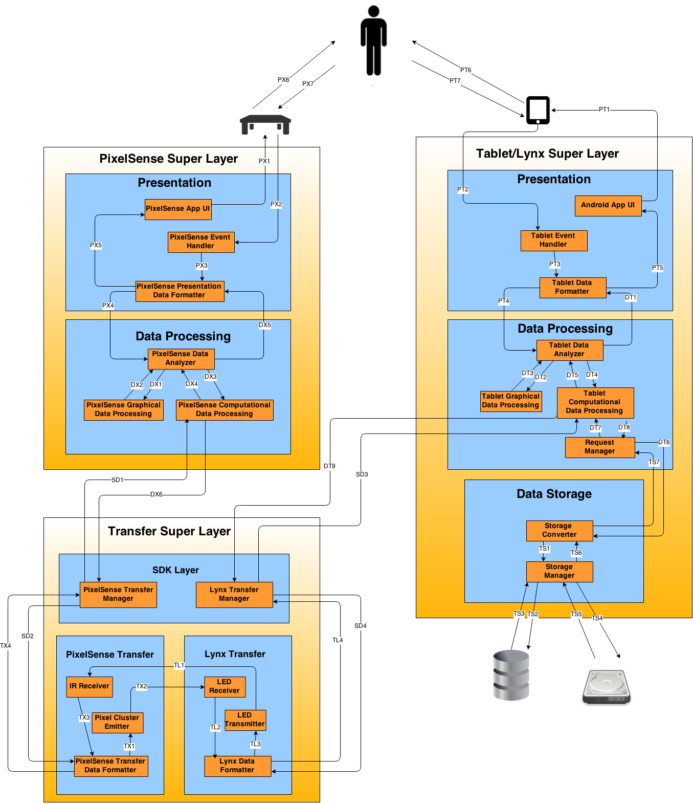
Architecture Diagram

Slide 8
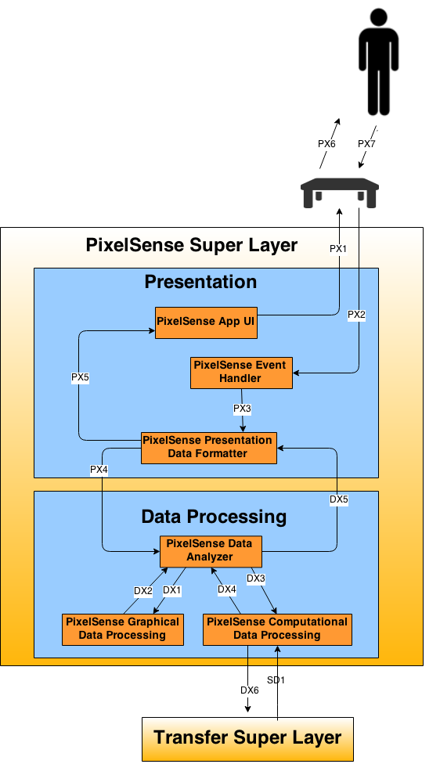

PixelSense Super Layer
Presentation Layer
Purpose: Present data on the Pixelsense Table to the user
This layer will also serve as main source of input from the user to the system.
Data Processing Layer
Purpose: Process data and send/receive data to the Transfer Super Layer.

Slide 9
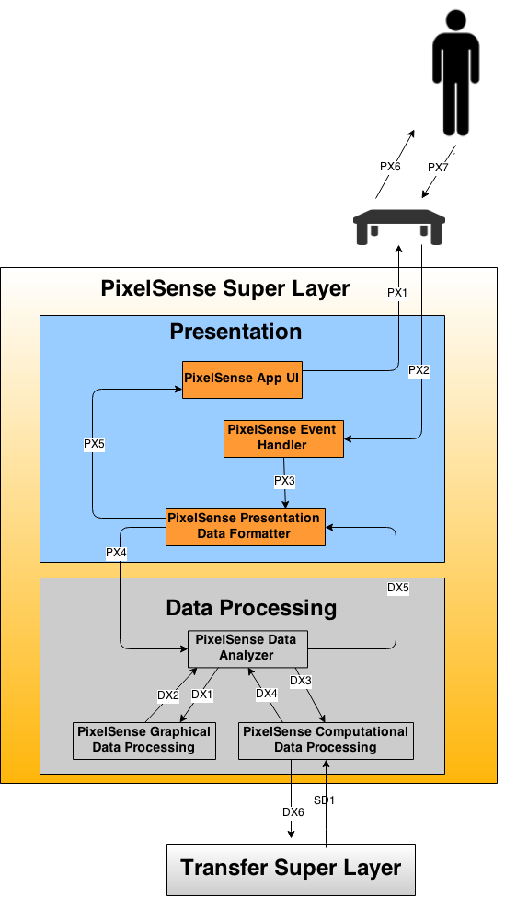
PixelSense Presentation Subsystems
PixelSense App UI
General Description:
Provides a user interface for the PixelSense Table.
Responsibilities:
The responsibility of PixelSense App UI subsystem is to display the graphical as well as computational content to the user via PixelSense Table.
Public Interfaces:
Method | Description | Information Required | Information Returned
displayPresentationData | Displays the data to the table. | None | Data

Slide 10
PixelSense Presentation Subsystems
PixelSense Event Handler
General Description:
Handles user input from table.
Responsibilities:
Receive input from user from PixelSense Table
Send input data to Data Formatter
Public Interfaces:
Method | Description | Information Required | Information Returned
getData | receievs raw input from user | None | None

Slide 11
PixelSense Presentation Subsystems
PixelSense Data Formatter
General Description:
PixelSense Data Formatter subsystem will accept the input from the Event Handler subsystem. The formatter will then pre-process the data and translate it into a form that is acceptable for Data process Layer.
Responsibilities:
The responsibility of PixelSense Data Formatter subsystem is to accept the input in various forms and translate it into acceptable form. The formatter should structure the data in such a way that it is easy to process.
Inter-Layer Interfaces:
Method | Description | Information Required | Information Returned
getAnalyzedData | Gets Analyzed data from Data Analyzer subsystem in Data Processing Layer for display purposes. | analyzed data | None
sendFormattedData | Sends formatted data to Data Analyzer for further data process. | None | Formatted data

Slide 12
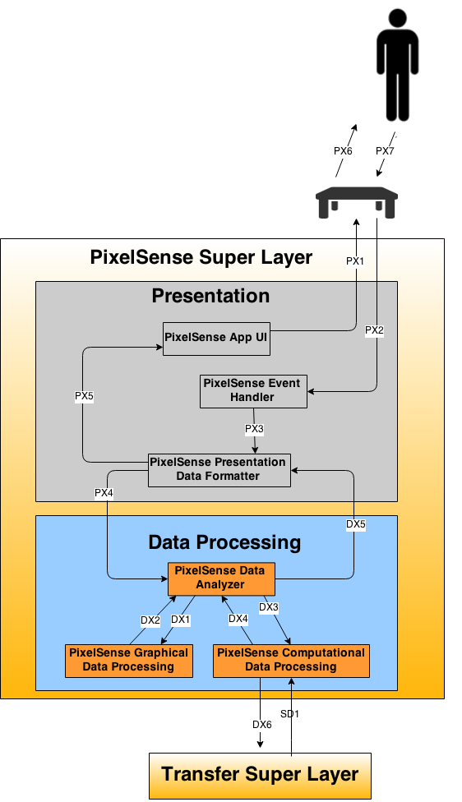
PixelSense Presentation Subsystems
PixelSense Data Analyzer
General Description:
PixelSense Data Formatter subsystem analyzes the formatted data and identifies if it is graphical data or computational data. After separation of data, graphical data will be sent to graphical data processor and computational data will be sent to computational data processing. It also sends back the analyzed data to data formatter in presentation layer.
Responsibilities:
The Responsibility of PixelSense Data Analyzer is to separate graphical and computational input and send it to respective subsystems.
. Inter-Layer Interfaces:
Method | Description | Information Required | Information Returned
getFormattedData | Gets formatted data from Data formatter subsystem in presentation Layer for further process. | formatted data | None
sendAnalyzedData | Sends analyzed data to Data formatter for display purposes. | None | analyzed data

Slide 13
PixelSense Presentation Subsystems
PixelSense Graphical Data Processing
General Description:
This subsystem will receive data from the PixelSense Data Analyzer Subsystem, it processes that information, and then returns the processed information to the PixelSense Data Analyzer subsystem as relevant graphical data.
Responsibilities:
This subsystem is responsible for receiving data from the PixelSense Data Analyzer subsystem. Then it processes the data needed for any graphical operations and then sends the processed data back to the PixelSense Data Analyzer subsystem.
.
Interfaces:
None

Slide 14
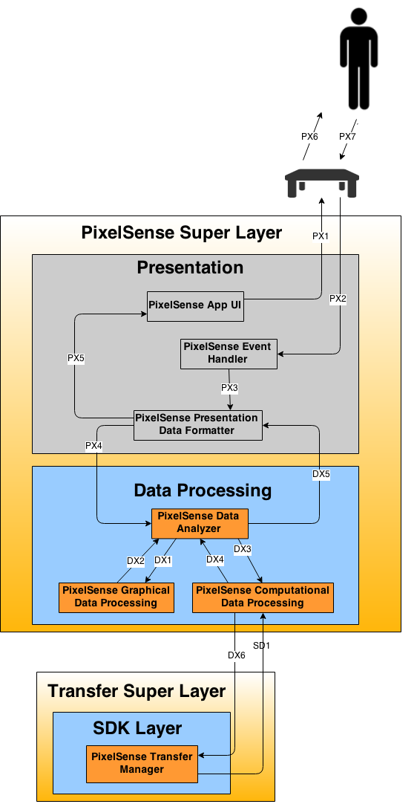
PixelSense Presentation Subsystems
PixelSense Computational Data Processing
General Description:
This subsystem will receive data from the PixelSense Data Analyzer subsystem, process that information, and then forwards the processed information to the PixelSense Transfer Controller subsystem in SDK layer as relevant computational (non-graphical) data.
Responsibilities:
This subsystem processes the data needed for any computational operations and then sending the processed data back to the PixelSense Data Analyzer subsystem or the PixelSense Transfer Controller in SDK layer subsystem depending on where the data is coming.
.
Inter-Layer Interfaces:
Method | Description | Information Required | Information Returned
sendData | Sends computation data to PixelSense Transfer Layer | None | binary data

Slide 15
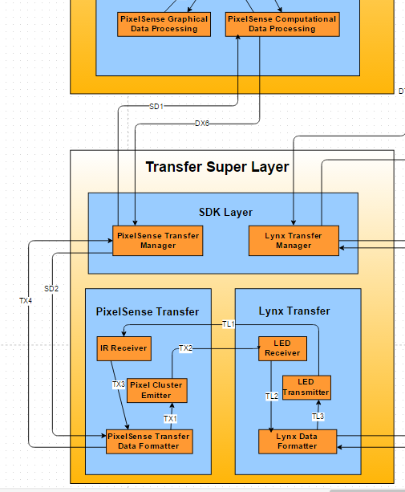
Transfer SDK Subsystems
PixelSense Transfer Manager
General Description:
The PixelSense Transfer Manager will accept data and send it off for transfer over light.
Responsibilities:
PixelSense Transfer Manager is responsible for taking in the data from the processing layer and then formatted it to be sent to the transfer layer
Inter-Layer Interfaces:
Method | Description | Information Required | Information Returned
sendSDKData | Sends the data processed by the SDK to the formatter | none | None
receiveSDKData | Receive formatted data for processing to digital data by the SDK. | none | none
getProcessedData | Gets processed data from the Data Processing Layer in the PixelSense Super Layer | computational data | None
sendDataToProcessed | Sends received data back to the Data Processing Layer in the PixelSense Super Layer | none | none

Slide 16
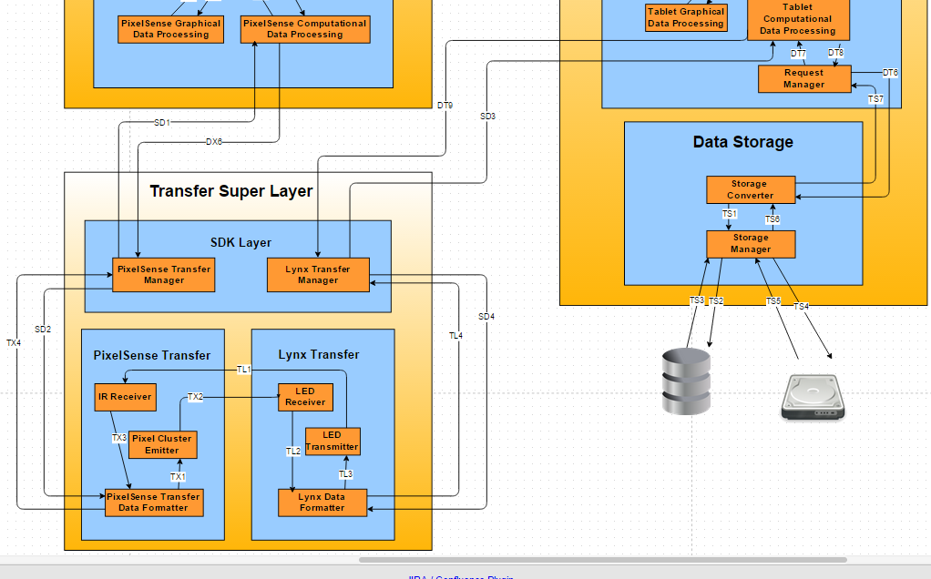
Transfer SDK Subsystems
Lynx Transfer Manager
General Description:
The Lynx Transfer Manager will accept data and send it off for transfer over light.
Responsibilities:
Lynx Transfer Manager is responsible for taking in the data from the processing layer and then formatted it to be sent to the transfer layer
Inter-Layer Interfaces:
Method | Description | Information Required | Information Returned
getProcessedData | Gets processed data from the Data Processing Layer in the PixelSense Super Layer | computational data | None
sendDataToProcessed | Sends received data back to the Data Processing Layer in the PixelSense Super Layer | none | none
sendSDKData | Sends the data processed by the SDK to the formatter | none | None
receiveSDKData | Receive formatted data for processing to digital data by the SDK. | none | none

Slide 17
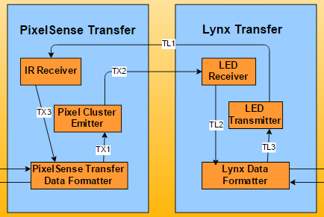
PixelSense Transfer Subsystems
IR Receiver
General Description:
The IR receiver detects raw light and sends it off to the PixelSense Data Formatter.
Responsibilities:
This is responsible for detecting any light that is transmitted over between the table and Lynx device
Inter-Layer Interfaces:
Method | Description | Information Required | Information Returned
detectLight | This detects any light transmitted from the Lynx device | none | None

Slide 18
PixelSense Transfer Subsystems
Pixel Cluster Emitter
General Description:
The Pixel Cluster Emitter replicates an LED to emit light
Responsibilities:
This is responsible for emitting the data over light through a group of pixels.
Inter-Layer Interfaces:
Method | Description | Information Required | Information Returned
sendLight | This sends the data over light through clustered pixels | none | None

Slide 19
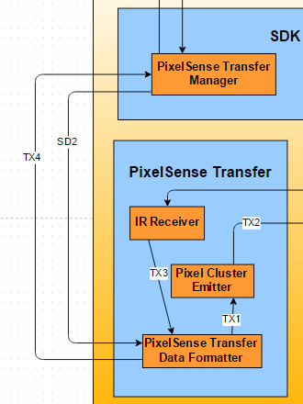
PixelSense Transfer Subsystems
Pixel Transfer Data Formatter
General Description:
Converts SDK data to raw data and vice versa
Responsibilities:
This is responsible for formatting the data appropriately so the emitters and the SDK can understand
Inter-Layer Interfaces:
Method | Description | Information Required | Information Returned
sendSDKData | Sends the data processed by the SDK to the formatter | none | None
receiveSDKData | Receive formatted data for processing to digital data by the SDK. | none | none

Slide 20
Lynx Transfer Subsystems
LED Receiver
General Description:
The LED receiver detects raw light and sends it off to the PixelSense Data Formatter.
Responsibilities:
This is responsible for detecting any light that is transmitted over between the table and Lynx device
Inter-Layer Interfaces:
Method | Description | Information Required | Information Returned
detectLight | This detects any light transmitted from the PixelSense | none | None

Slide 21
Lynx Transfer Subsystems
LED Emitter
General Description:
The LED Emitter emits the data over some light sequences through LEDs
Responsibilities:
This is responsible for emitting the data over light through a group of LEDS
Inter-Layer Interfaces:
Method | Description | Information Required | Information Returned
sendLight | This sends the data over light through an array of LEDs | none | None

Slide 22
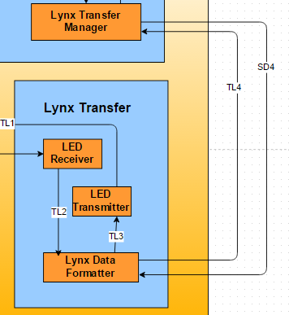
Lynx Transfer Subsystems
Lynx Data Formatter
General Description:
Converts SDK data to raw data and vice versa
Responsibilities:
This is responsible for formatting the data appropriately so the emitters and the SDK can understand
Inter-Layer Interfaces:
Method | Description | Information Required | Information Returned
sendSDKData | Sends the data processed by the SDK to the formatter | none | None
receiveSDKData | Receive formatted data for processing to digital data by the SDK. | none | none

Slide 23
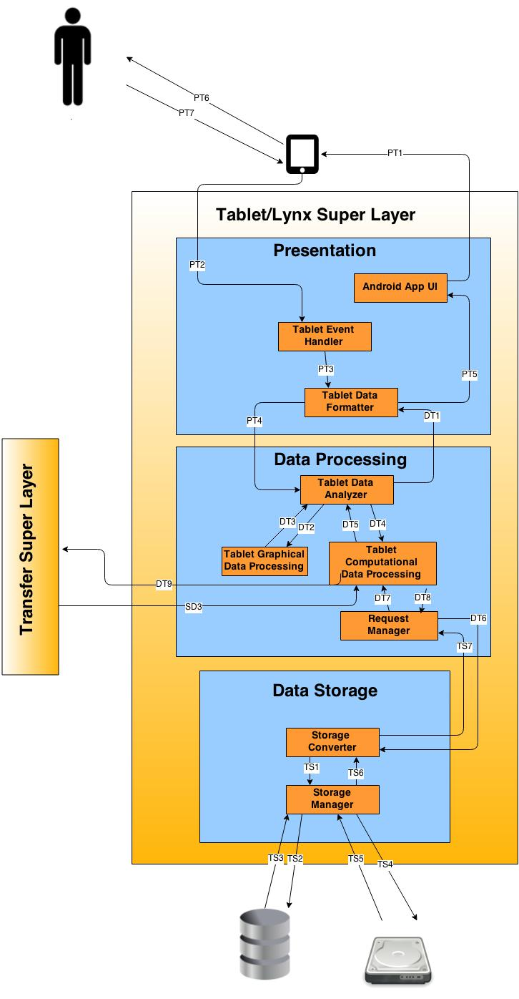
Tablet/Lynx Superlayer
Presentation Layer
Purpose: present data on the Lynx to the user via Android tablet
Data Processing Layer
Purpose: process data, request stored data, and send data to the Transfer Superlayer
Data Storage Layer
Purpose: store relevant data (such as transaction logs)

Slide 24
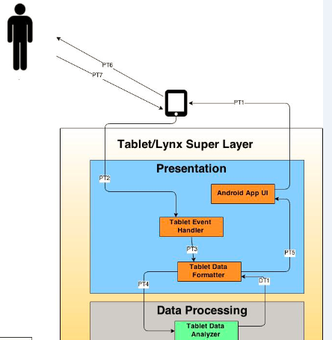
Tablet/Lynx Presentation Layer
Android App UI
General Description:
provides a user interface for the Lynx/Tablet
Responsibilities:
Display user info, commands, & transaction log
Interfaces:
Method | Description | Information Required | Information Returned
displayPresentationData | Displays the data to the tablet. | None | Data

Slide 25
Tablet/Lynx Presentation Layer
Tablet Event Handler
Description:
Handles user input from tablet
Responsibilities:
Receive input from user
Send input data to Data Formatter
Interfaces:
Method | Description | Information Required | Information Returned
getData | receives raw input from user | None | None

Slide 26
Tablet/Lynx Presentation Layer
Tablet Data Formatter
Description:
Formats data to be sent to the App UI or Data Processing Layer
Responsibilities:
Format data from Event Handler and Data Processing layer
sends formatted data to next subsystem
Interfaces:
Method | Description | Info Required | Info Returned
getAnalyzedData | Gets Analyzed data from Data Analyzer subsystem in Data Processing Layer for display purposes. | computational data | None
sendFormattedData | Sends formatted data to Data Analyzer for further data process. | None | Formatted data

Slide 27
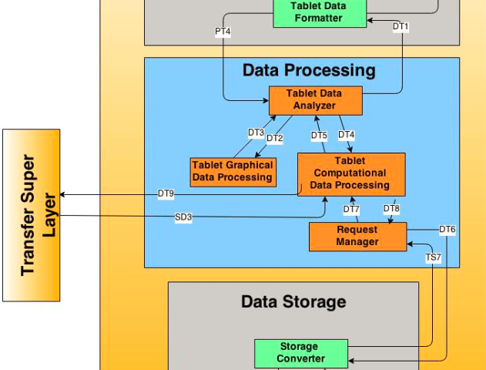
Tablet/Lynx Data Processing Layer
Tablet Data Analyzer
General Description:
Analyzes data that will be or has been processed
Responsibilities:
Determines processing type (graphical or computational)
Sends data to determined subsystem
Interfaces:
Method | Description | Info Required | Info Returned
getFormattedData | Gets formatted data from Presentation Layer. | Formatted data | None
sendProcessedData | Returns the processed data to the Presentation Layer | None | Processed data

Slide 28
Tablet/Lynx Data Processing Layer
Tablet Graphical Data Processing
General Description:
Processes graphical data for Presentation Layer
Responsibilities:
Process graphical data from Data Analyzer
Return processed data to Data Analyzer
Interfaces:
none

Slide 29
Tablet/Lynx Data Processing Layer
Tablet Computational Data Processing
General Description:
Processes general data (non-graphical)
Responsibilities:
Process received data
Return processed data to Data Analyzer
Request stored data via Request Manager
Send data to Transfer Superlayer
Interfaces:
Method | Description | Info Required | Info Returned
getData | Gets computational data from computational processing subsystem. | Binary Data | None
sendData | Sends computation data to Transfer Super Layer. | None | Binary Data

Slide 30
Tablet/Lynx Data Processing Layer
Request Manager
General Description:
Manages requests for data from the Data Storage Layer
Responsibilities:
receives request for data from processing
Sends requests to Data Storage Layer
Interfaces:
Method | Description | Info Required | Info Returned
getData | Sends request for stored data to the Data Storage Layer. | Request | Stored Data
storeData | Sends request to store data to the Data Storage Layer | Data to store | none

Slide 31
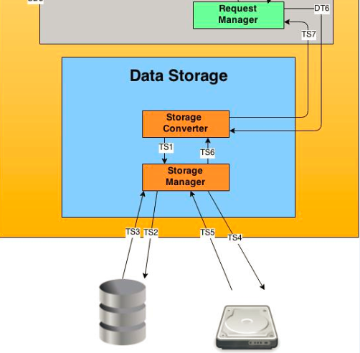
Tablet/Lynx Data Storage Layer
Storage Converter
General Description:
Convert requests into relevant queries
Responsibilities:
Converts data requests into queries
Submits queries to Storage Manager
Return requested data
Interfaces:
Method | Description | Info Required | Info Returned
returnData | Sends requested data to the Data Processing Layer. | none | Stored Data
getRequest | Gets the request for data from the Data Processing Layer | none | Request

Slide 32
Tablet/Lynx Data Storage Layer
Storage Manager
General Description:
Manage stored data on Android Tablet
Responsibilities:
Process queries
Return data to Storage Converter
Interfaces:
Method | Description | Info Required | Info Returned
executeQuery | Executes query to SQLite database. | Query | Stored Data
returnData | Returns data relevant to the executed query | None | Stored Data

Slide 33
Architecture Diagram

Slide 34
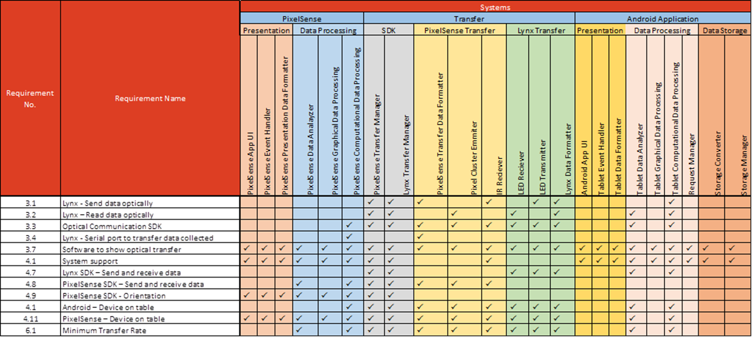
Requirements Mapping

Slide 35
OS Dependencies
PixelSense Super Layer
Windows 7
Surface 2.0 SDK
Tablet/Lynx Super Layer
Presentation Layer
Android SDK GUI Options
Data Storage Layer
SQLite Database options
Transfer Layer
Microcontroller Dependency

Slide 36
Testing Considerations
Overall Considerations
Code Compliance - Compliance with task and function of a subsystem as defined in ADS
Principle Adherence - Compliance with overall design principles as defined in ADS

Slide 37
Testing Considerations
Special Consideration
Diagnostic Subsystem
Implemented in both Processing Layers, designed to
track data through each subsystem
Transfer Super Layer data transformations will be
recorded on diagnostic system of receiving Processing
Layer

Slide 38

Questions?

